Slide 1
Two-Sample t Test Independent Samples Design
Class Notes by A.Sandanasamy, BHC.

Slide 2
Sometimes researchers will want to compare the means for two groups - two-sample t tests can be used instead.
The independent samples design involves two separate and unrelated samples for which each participant provides one score.
Class Notes by A.Sandanasamy

Slide 3
SAMPLING DISTRIBUTION OF THE DIFFERENCE BETWEEN MEANS
we will be comparing our obtained difference between means to a theoretical sampling distribution in order to determine if the difference between our means is significant.
The theoretical sampling distribution is referred to as the sampling distribution of the difference between means.
two samples of size n1 and size n2.
the difference between those means (M1 – M2)
Class Notes by A.Sandanasamy

Slide 4
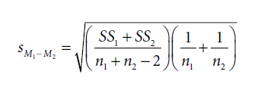
CALCULATIONS
Standard Error of Difference
The standard deviation of the sampling distribution of the difference between means is called the standard error of difference between means, and it is calculated with the formula below:
Class Notes by A.Sandanasamy

Slide 5
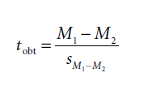
Formula for the t Test, Independent Samples Design
If a two-tailed test is used, tobt may be either positive or negative. If a one-tailed test is used, the alternative hypothesis (H1) will specify one of the means to be higher or lower than the other.
Class Notes by A.Sandanasamy

Slide 6

Degrees of Freedom
Because two samples are being used, degrees of freedom (df) for the independent samples t test will be based on two data sets, as follows:
Class Notes by A.Sandanasamy

Slide 7
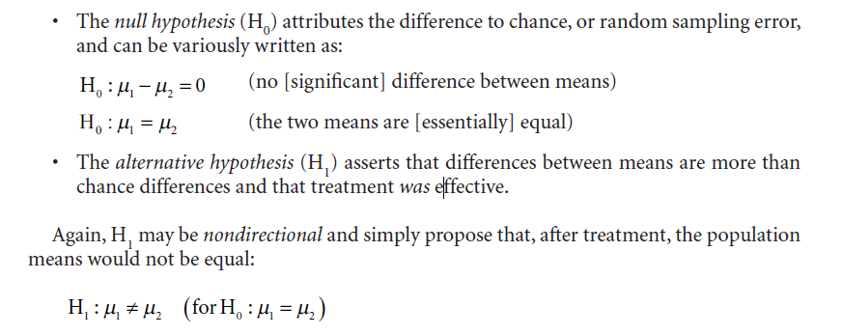
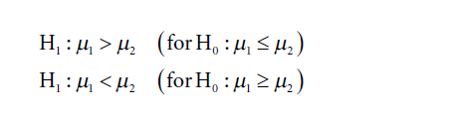
HYPOTHESIS TESTING

Slide 8
A political science teacher wonders whether there is a difference in knowledge of current events between students who read newspapers and those who watch the news on television. He randomly assigns students to one of two groups. Group 1 is instructed to read only the daily news-papers (either online or hard copies) for the next 30 days, whereas Group 2 is instructed to only watch the nightly news. Both groups are thereafter given a test to assess their knowledge of current events. The following scores are obtained. Conduct a nondirectional
t test with α = .05.
Class Notes by A.Sandanasamy

Slide 9
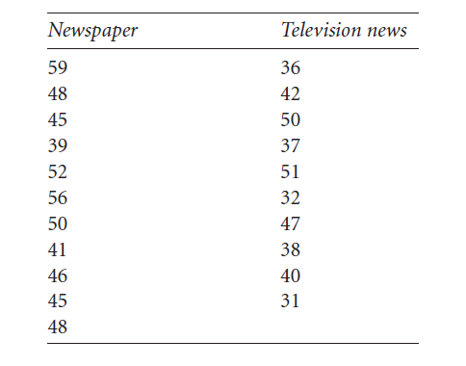
Class Notes by A.Sandanasamy

Slide 10
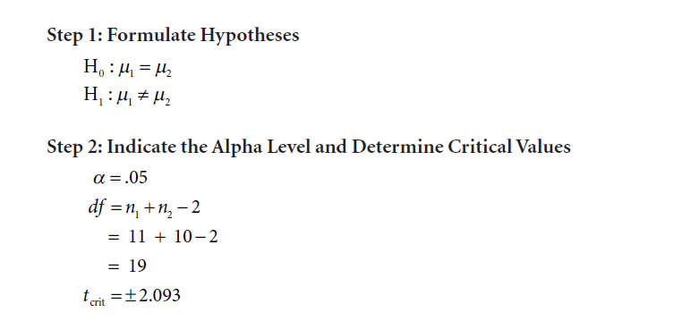
Class Notes by A.Sandanasamy

Slide 11
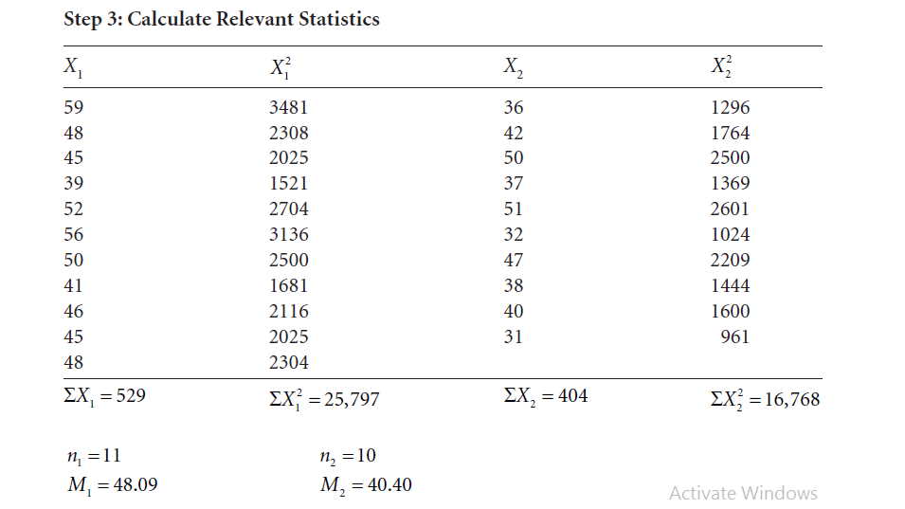
Class Notes by A.Sandanasamy

Slide 12
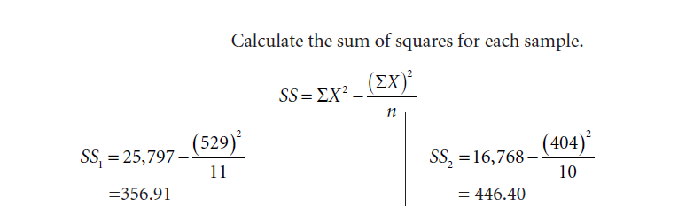
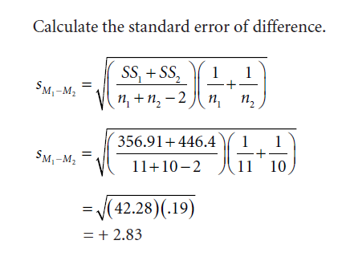
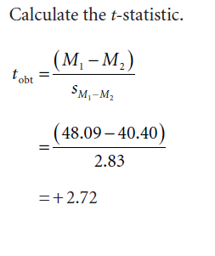
Class Notes by A.Sandanasamy

Slide 13
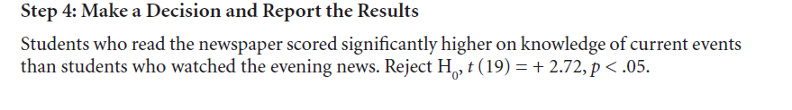
Class Notes by A.Sandanasamy

Slide 14
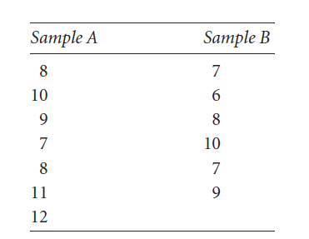
Research Question .
An industrial/organizational psychologist studying work habits and environment is interested in the effects of music on productivity. He decides to test this relationship by measuring the output of widgets at a large widget manufacturing company. Two samples are obtained and randomly assigned to one of two groups. Group A listens to smooth jazz during the workday. Group B is not exposed to music during the workday. The number of widgets produced over a 40-hour week is recorded and listed on the next page. Does listening to smooth jazz music affect widget productivity? Conduct a nondirectional test with α = .05.
Class Notes by A.Sandanasamy

Slide 15
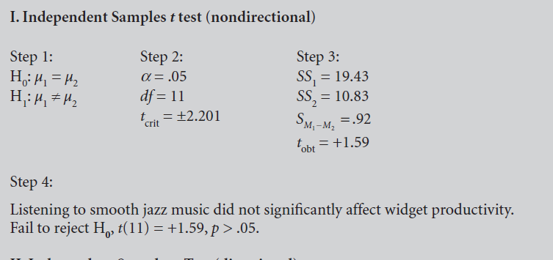
Class Notes by A.Sandanasamy

Slide 16
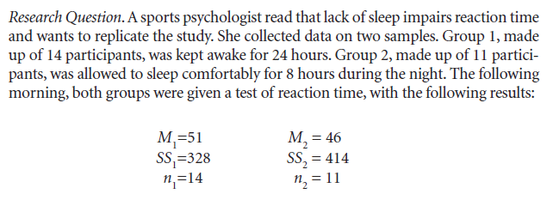
Reaction time refers to the amount of time it takes to react to a situation. Thus, higher scores indicate worse performance. Conduct a one-tailed test with α = .05 to determine if sleep deprivation had a detrimental effect on reaction time.

Slide 17
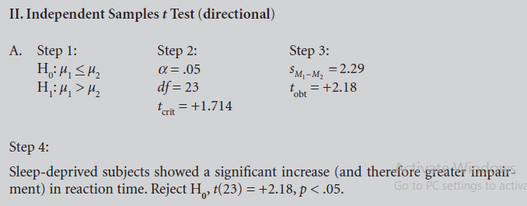

Slide 18
Two-Sample t Test Related Samples Design

Slide 19
A repeated measures study involves pre- and post-testing of the same subjects after some treatment intervention.
This design is also called a within-subjects design, highlighting the fact that scores within the same subject group are compared.
For example: Subjects’ anxiety scores before psychotherapy are compared with their anxiety scores after psychotherapy. Is there enough of a mean difference in the pre- and post-conditions to conclude significance?

Slide 20
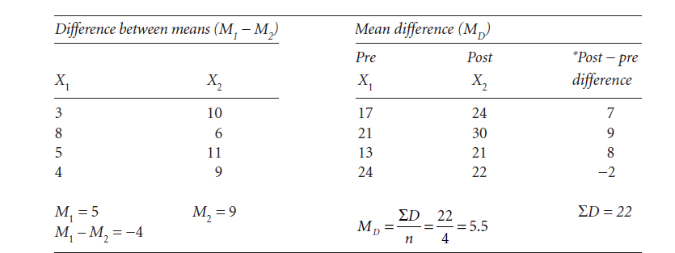
SAMPLING DISTRIBUTION OF MEAN DIFFERENCES

Slide 21
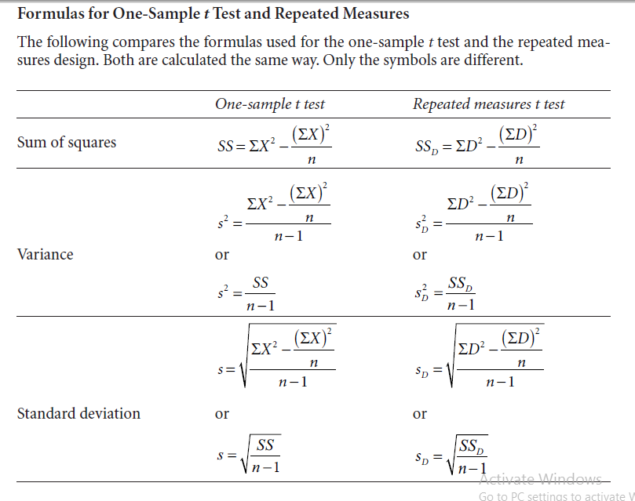
Two-Sample t Test Related Samples Design

Slide 22


Slide 23
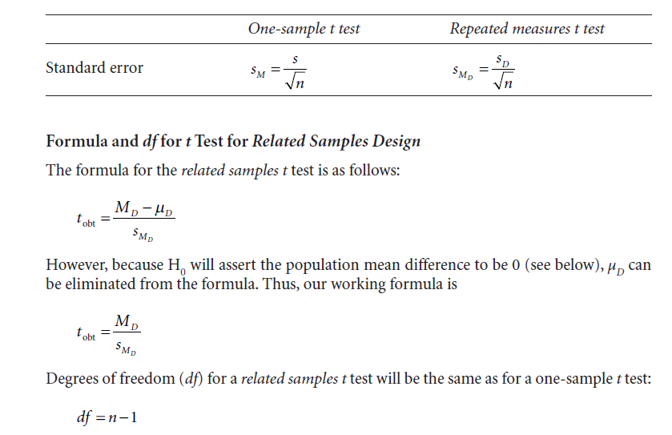

Slide 24
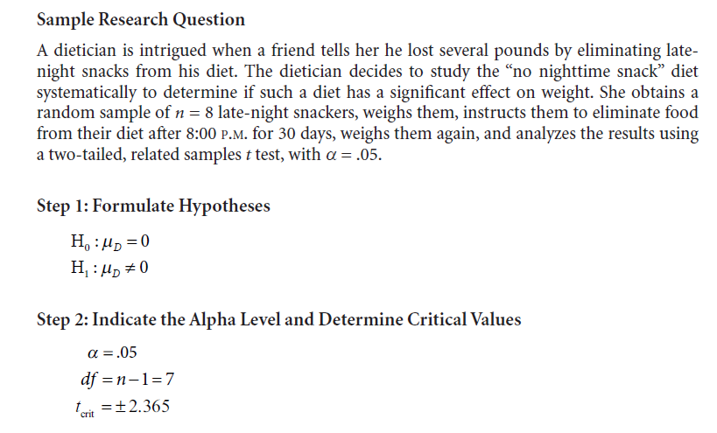

Slide 25
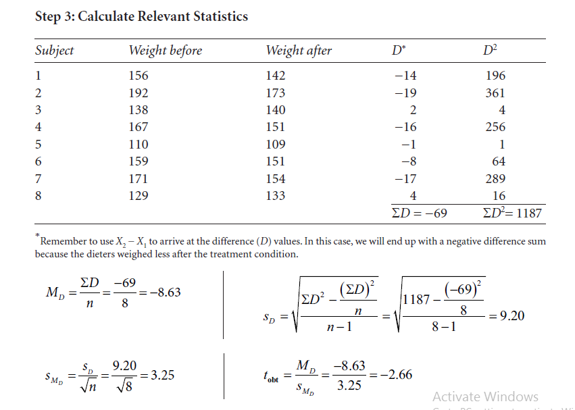

Slide 26
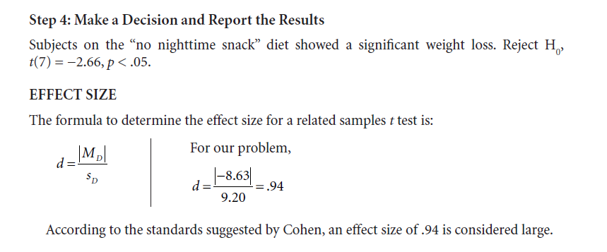

Slide 27
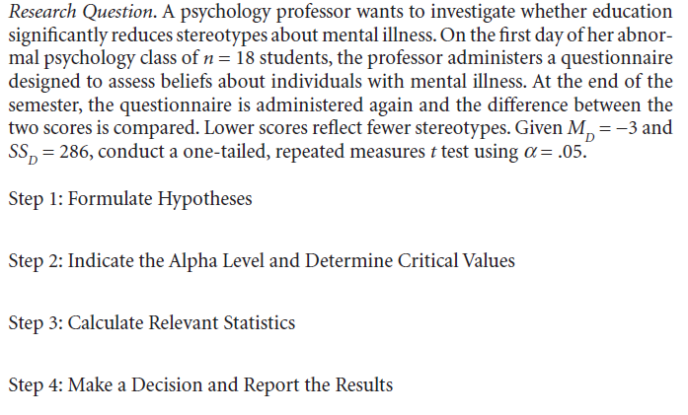

Slide 28
